Slide 1




Year 11 Options Process
2025-2026

Slide 2
Completion of ILPP: September 2025 to April 2026
YEAR 11 OPTIONS LAUNCH: Week beginning
10th November 2025
OPTION SUBJECT INFORMATION AVAILABLE ON THE SCHOOL WEBSITE: December 2025
FREE CHOICE SURVEY: 19th January – 2nd February 2026 – the decisions made by pupils at this stage are used to help formulate the Sixth form option grid.
KEY STAGE 5 SUBJECT OPTION TALKS IN LESSONS / ASSEMBLIES: December 2025 onwards
SIXTH FORM OPTIONS OPEN EVENING:
15th January 2026
Year 11 Options Process
2025-26
YEAR 11 OPTIONS GRID AVAILABLE
13th February 2026
INDIVIDUAL STUDENT INTERVIEWS:
24th, 25th and 26th February 2026
SIXTH FORM APPLICATION DEADLINE:
9th March 2026.

Slide 3

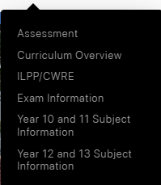
All the information you need is on the website
Click here and go to the Yr 12 / 13 subject information page
All information about subjects and admissions can be found in the Sixth Form Prospectus

Slide 4
Completion of ILPP: September 2025 to April 2026
YEAR 11 OPTIONS LAUNCH: Week beginning
10th November 2025
OPTION SUBJECT INFORMATION AVAILABLE ON THE SCHOOL WEBSITE: December 2025
FREE CHOICE SURVEY: 19th January – 2nd February 2026 – the decisions made by pupils at this stage are used to help formulate the Sixth form option grid.
KEY STAGE 5 SUBJECT OPTION TALKS IN LESSONS / ASSEMBLIES: December 2025 onwards
SIXTH FORM OPTIONS OPEN EVENING:
15th January 2026
Year 11 Options Process
2025-26
YEAR 11 OPTIONS GRID AVAILABLE
13th February 2026
INDIVIDUAL STUDENT INTERVIEWS:
24th, 25th and 26th February 2026
SIXTH FORM APPLICATION DEADLINE:
9th March 2026.

Slide 5
Example Option Grid
Option A | Option B | Option C | Option D | Option E | Option F
Art | Biology | Advanced Skills Baccalaureate Wales | Art Photography | Extended Project | Rugby Academy
Business Studies | Economics | Biology | Biology
Chemistry | English Language and Literature | BTEC Business | Chemistry
Computer Science | Geology | Chemistry | English Literature
BTEC Food and Nutrition | BTEC IT | Drama | Geography
History | Mathematics and Further Mathematics |  | History
Law | L3 Medical Science | Media Studies | Mathematics
Mathematics | Physics | Physical Education | Music
Sociology | Product Design - DT | Physics | Physics
Welsh | Law | Politics | Psychology
- | Philosophy and Ethics | - | L3 Sport
Choice | Choice | Choice | Choice | Choice | Choice

Slide 6
Completion of ILPP: September 2025 to April 2026
YEAR 11 OPTIONS LAUNCH: Week beginning
10th November 2025
OPTION SUBJECT INFORMATION AVAILABLE ON THE SCHOOL WEBSITE: December 2025
FREE CHOICE SURVEY: 19th January – 2nd February 2026 – the decisions made by pupils at this stage are used to help formulate the Sixth form option grid.
KEY STAGE 5 SUBJECT OPTION TALKS IN LESSONS / ASSEMBLIES: December 2025 onwards
SIXTH FORM OPTIONS OPEN EVENING:
15th January 2026
Year 11 Options Process
2025-26
YEAR 11 OPTIONS GRID AVAILABLE
13th February 2026
INDIVIDUAL STUDENT INTERVIEWS:
24th, 25th and 26th February 2026
SIXTH FORM APPLICATION DEADLINE:
9th March 2026.

Slide 7
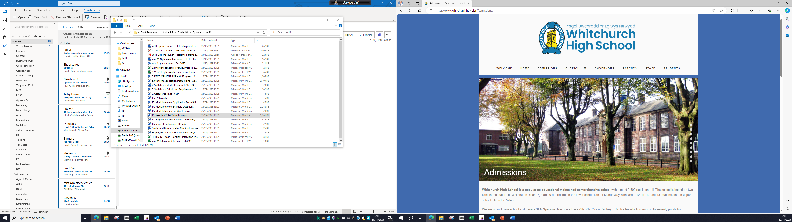
To apply for Sixth Form you will need to complete an online application. The link will be found on this page on or after February 13th.

Slide 8


Digital ILPP
Individual Learning Pathway Plan – Year 11
The purpose of the ILPP is to provide you with information and direction for your next steps following compulsory education.
It includes information about:
Skills and Qualities
CV writing and Letters of application
Interview Skills
The options process
Careers
Careers Wales
Pathways – alternatives to further education
Useful websites
Student finance
During your wellbeing sessions you will have dedicated time in computer rooms to work through the ILPP and complete the required assignments.

Slide 9
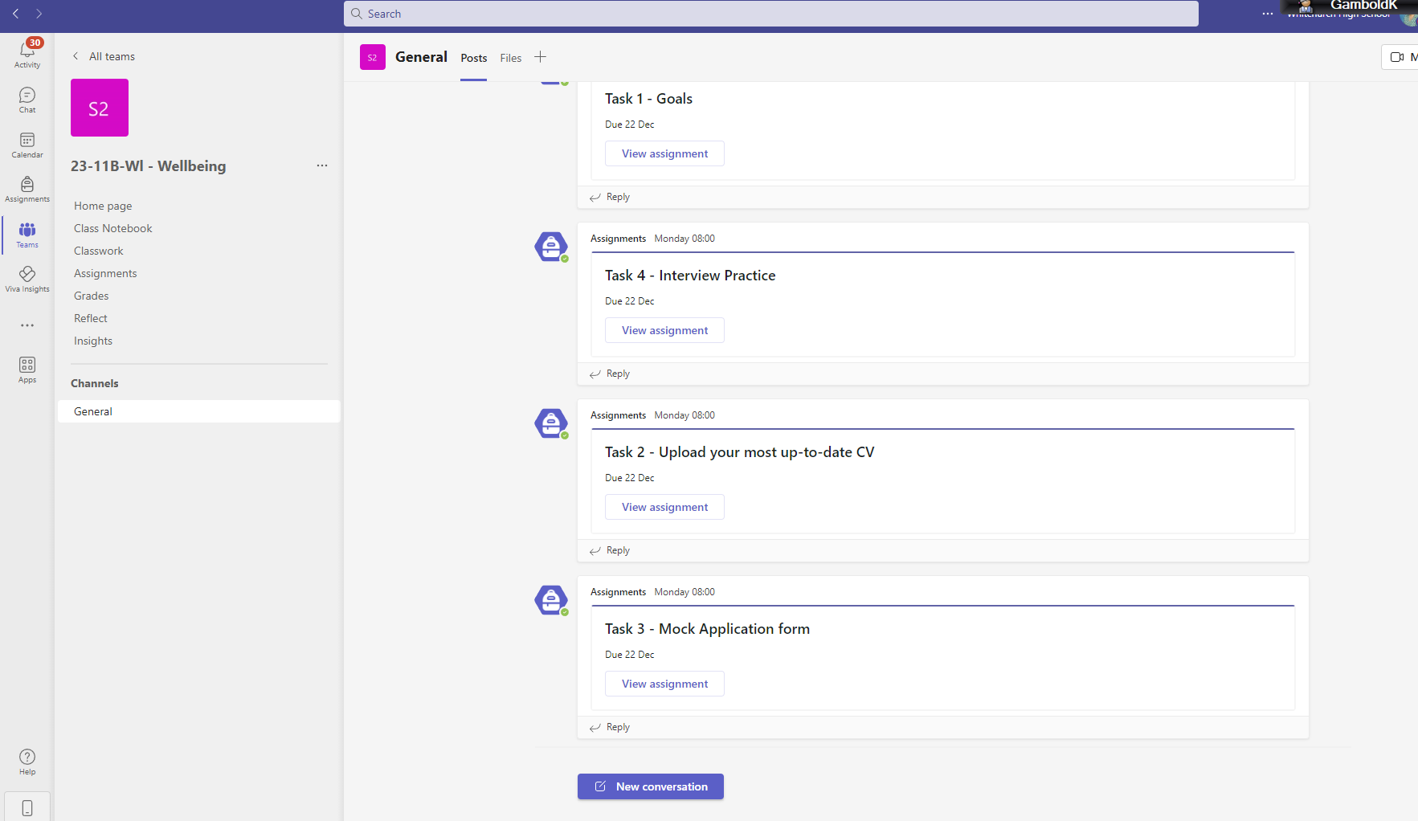
You access the ILPP through your wellbeing team.
Click on class notebook…

Slide 10
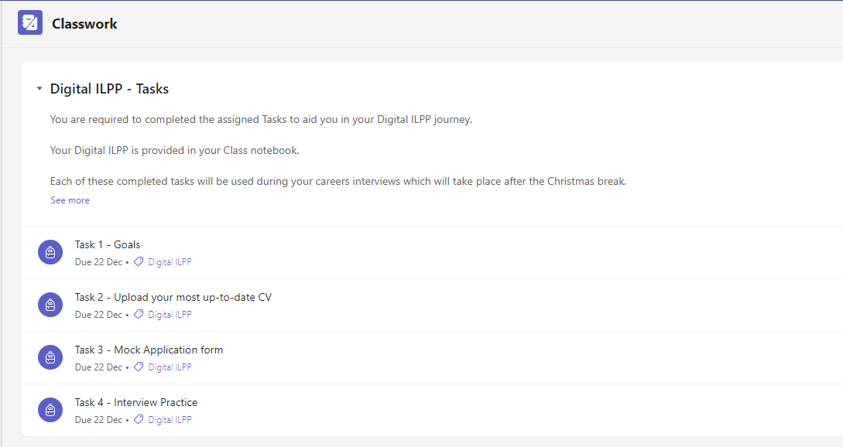
Assignments
There are FOUR assignments you are required to complete as part of this process.
All of these documents will be needed for your individual interviews in February.

Slide 11


Scott Gwynne
Careers Wales
Miss Leigh Holtzhausen
Careers Adviser

Slide 12

My role in school
Support pupils to make realistic and informed choices and implement plans.
To liaise and negotiate with other organisations with, and on behalf of, young people.
Providing support to identify and overcome barriers.
Help pupils to improve their application and interview skills.
Aid pupils to develop resilience in adapting their plans when circumstances change.

Slide 13

Options for your next steps:
Sixth Form
College
Apprenticeships
Employment / Jobs Growth Wales+

Slide 14




Staying in education…but where?

Slide 15


Staying in Education
School 6th Form or College to do A-Levels
Some degree subjects ask for specific A levels. Check entry requirements before choosing your A levels.
If you are thinking about studying at University, some degree subjects ask for specific A-Levels. Check entry requirements.
Certain ‘facilitating’ A-Levels can keep your options open for the future
Subjects at A-Level are a lot harder than at GCSE
Choose subjects you’ll enjoy
Try this useful tool: www.which.co.uk/alevelexplorer
Notes:
Explain that there are four points to consider: 1 minute
Some degree subjects ask for specific A levels
Certain A levels can keep your options for the future open e.g. by choosing a mixture of subjects such as Maths with Humanities etc
A levels are tougher than GCSEs.
Choose subjects you’ll enjoy.
The explorer tool is not available in Welsh.

Slide 16

Staying in Education
School or College - Vocational Courses (includes BTECs)
A practical-based, vocational qualification designed to lead to a job, an area of employment and / or further study including Higher Education.
BTECs can be refreshing, especially if you learn best by actually ‘doing’ rather than simply reading about a subject.
If you are thinking about studying at University, some degree subjects ask for specific Vocational subjects.
Check entry requirements.
Notes:
Explain that Vocational qualifications at level 3 are equivalent to A levels and can lead to HE study. 1 minute

Slide 17
Apprenticeships & Jobs Growth Wales +
Work-based Learning, combining work, qualifications and an income
APPRENTICESHIPS
These have to be applied for, much like you would apply for a job.
You earn while learning on-the-job and will also gain a qualification.
Apprenticeship Matching Service on careerswales.com
Jobs Growth Wales +
These are offered at different levels
Engagement includes varied work placements and support with English and Maths.

Slide 18
Year 11 Timeline
Colleges usually begin accepting applications in November onwards. Research courses on offer
Year 11
Individual Option Interviews
Attend the Sixth Form Open Evening to find out what’s on offer
GCSE exams begin
2025 2026
September October November December January February March April May June July August
Assembly talks providing an overview of Post 16 options.
Attend Open Evenings at colleges from Oct/Nov onwards to see what they have to offer.
Interested in apprenticeships? Speak to your Careers Adviser from February onwards to find out more
GCSE results are out
August 2026
Notes:
These next few months are when applications get sent- don’t delay until 100% sure, apply to keep options open. Consider finding out more about apprenticeship options now

Slide 19

What is your Plan B ?

Slide 20
Thank you for listening!
The Careers room is located in the corridor next to room 100 in the Admin corridor. Please email me to arrange an appointment at
Scott.Gwynne@careerswales.gov.wales
or
Gwynnes@whitchurch.cardiff.sch.uk

